Slide 1

NASA EVA Gamification
Phase II
Prepared By
Laura Addiego
Samia Alam
Kelli Corey
Charles Milk
Adeola Odusola
Hung Pham
Notes:
Samia

Slide 2
Project Background
The NASA Extravehicular Activity (EVA) group created a private wiki to support various operations at NASA International Space Station.
In an effort to increase user engagement and participation it was decided to integrate gaming mechanics into the NASA EVA Wiki which supports the group’s knowledge management processes.
Phase 1 of the project, completed during the Spring 2018 session, included:
user profile creation
email verification
database setup.
Notes:
Samia

Slide 3
Project Objective & Scope
The objective for Phase 2 of this project is to:
build a consolidated, scalable infrastructure for the NASA EVA wiki
incorporate different elements of gamification into the wiki
The scope of phase two of this project is to:
develop a simple point system
incorporate badges
add a leaderboard to the user’s profile
Notes:
Samia

Slide 4
Phase II Product Functionality

Slide 5
Points
Point reward is the basis of NASA EVA Gamification.
Wiki users will earn points based on their contribution to Media Wiki. Point earning will vary based on the type of action done. Different amount of points will be assigned to the wiki users based on whether they have added or edited a page.
The wiki users will gain 100 points when they create a new page
The wiki users will gain 50 points when they edit a page.
Total earned points will be used toward to badges generation.
The content quality of a post will not be counted in this phase. As long as the wiki users add and/or edit a page, they will gain points.
Notes:
Hung
*Points/Badges are customizable

Slide 6
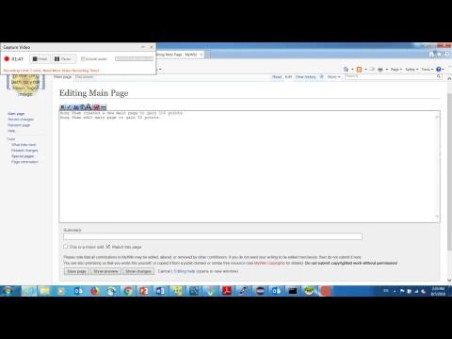
Walkthrough Video
Sample video of a wiki user named “Hpham” gaining their points toward their contribution.
Notes:
Hung

Slide 7
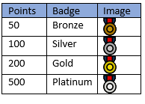
Badges
Badges are earned and given to wiki users based on points earned from creating and/or editing pages. The badges are generated on the fly and issued based on the current total points of each user, starting from the highest badge earnable to the lowest.
The point-to-badge allocation is shown below:
A user with 550 points will generate a platinum and bronze badge, starting from the highest badge possible.
Notes:
Adeola

Slide 8
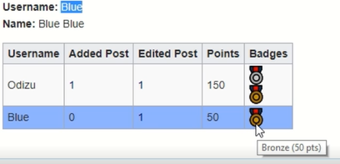
Leaderboard
The leaderboard, which is displayed on the profile page, is used to stimulate interest and competition among the wiki users. In the process, encouraging users to create pages and make edits with the goal of moving up the leaderboard.
The leaderboard displays each username, the count of pages added, count of pages edited, total points, and the badges earned. Only users within +/- 100 points of each user are displayed in each user’s profile page.
Notes:
Adeola

Slide 9
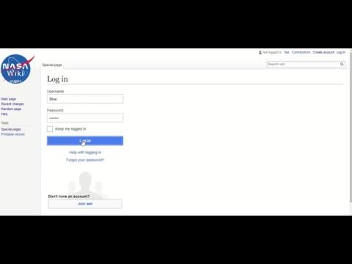
Walkthrough Video
Sample video of a user named “Blue” making their first contribution to the wiki.
Notes:
Adeola

Slide 10
Test Summary
Unit Testing
Tested each line of codes and functions
100% of the test cases passed
Functional Testing
Tested Functionalities of the new features based on requirement specifications
100% of the test cases passed
2 minor issues found and resolved
Database Testing
Tested Revision table after altering the table to add new column
100% of the test cases passed
Performance Testing
Tested performance of different Media Wiki pages after applying the code and database changes
100% of the test cases passed
Regression Testing
Final regression of the application performed after the fixes
Notes:
Samia

Slide 11
Documentation

Slide 12
Handover Documentation
The handover documentation for this phase includes:
Phase 2 MediaWiki Basics document
Phase 2 MediaWiki Installation (CentOS)
Phase 2 MediaWiki Installation (Windows)
Phase 2 Future Recommendations document
Phase 2 Configuration and Privacy document
Phase 2 Software Requirements Specification (SRS)
Phase 2 Code documentation (posted to GitHub)
Notes:
Chuck

Slide 13
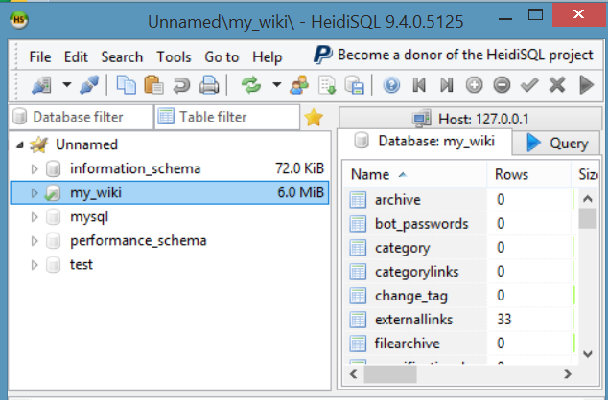
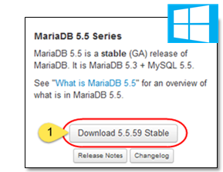
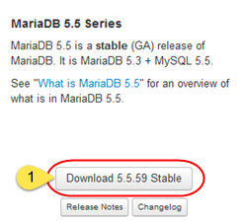
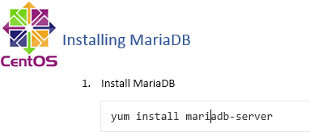
Installation Instructions: 1. Database
Both MariaDB and MySQL are supported by MediaWiki
MariaDB has been used for the project
Install MariaDB 5.5.[latest version] through https://downloads.mariadb.org/mariadb/.
Access the database through HeidiSQL
Get detailed installation instructions from the handover document
MariaDB installation
HeidiSQL
Notes:
Laura

Slide 14
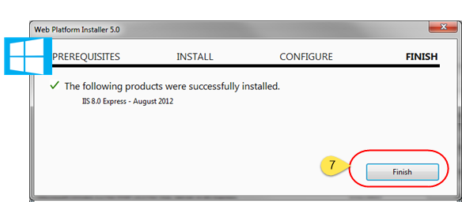

Installation Instructions:
2. Web Server
Install IIS Express through Microsoft Web Platform Installer (WPI)
Get detailed installation instructions from the handover document
Successful Installation of IIS Express
Notes:
Laura

Slide 15
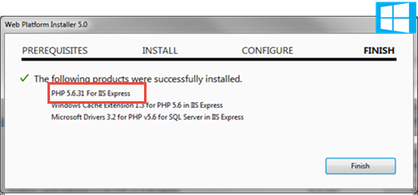
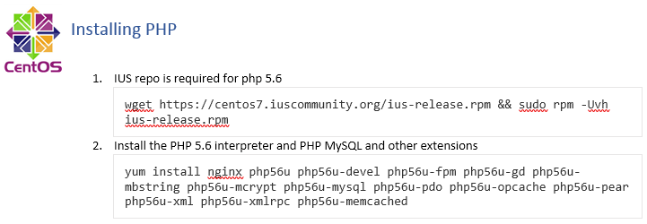
Installation Instructions:
3. Coding Language
PHP is the coding language used by MediaWiki
Install PHP 5.6 through Microsoft Web Platform Installer (WPI)
Get detailed installation instructions from the handover document
Successful Installation of PHP
Notes:
Laura

Slide 16

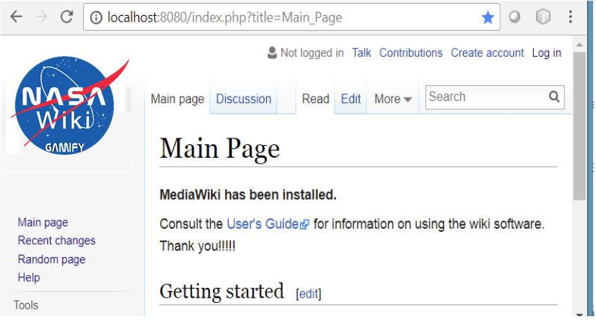
Installation Instructions:
4. MediaWiki
MediaWiki is an open source wiki platform
Download the latest version of MediaWiki from https://www.mediawiki.org/wiki/Download
Get detailed installation instructions from the handover document
MediaWiki after successful download and setups
Notes:
Laura

Slide 17
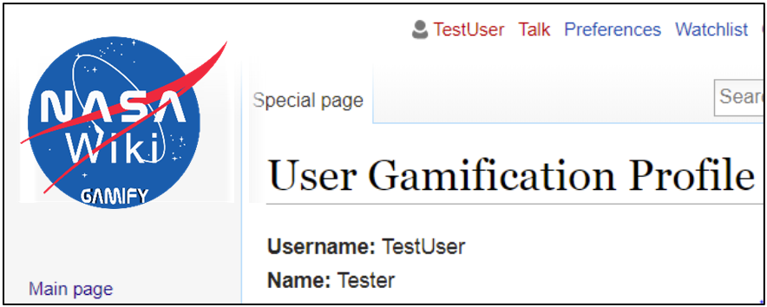
Installation Instructions: 5. NASA EVA Gamification Extension
Obtain the code from [GitHub](https://github.com/SWEN670NASAEVA2/NASA_EVA_Gamification)
Follow the detailed installation instructions from the handover document
After successful configurations, User Gamification Profile link will be visible in Special Page section of MediaWiki.
User Gamification Profile in MediaWiki
Notes:
Laura

Slide 18
Post-Implementation Review

Slide 19
Project Performance
Benefits
User engagement incentivized
Objectives
Infrastructure is scalable
Gamification elements incorporated
Scope
Project completed in-scope
Deliverables
All deliverables promised were completed and delivered
Notes:
Kelli

Slide 20
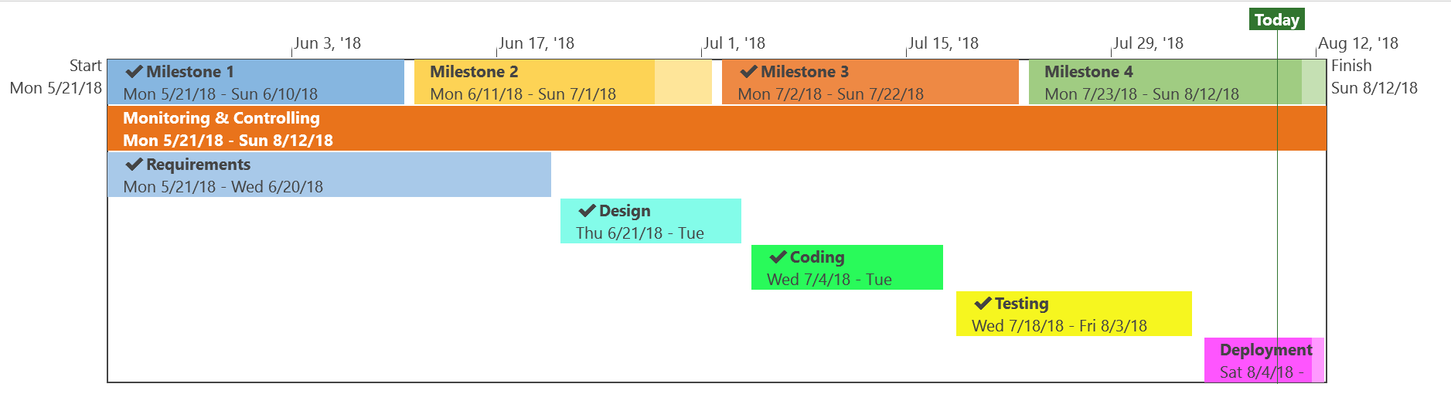
Project Conformance
Time Management
Project was completed on-schedule
Quality Management
Project conformed to quality management plan
Change Management
No changes requested by stakeholders
Risk Management
Project conformed to risk management plan
Communications Management
Project conformed to communications management plan
Notes:
Kelli
Insert timeline img

Slide 21
Project Achievements
Development of a scalable infrastructure
Implementation of a basic gamification rules and norms
Collection and analysis of requirements for future phases
Development of an aesthetically appealing logo and theme
Significant clarification of instructions to ease on-boarding for future development teams
Clarification and standardization of current and future requirements to ease development by future teams
Notes:
Kelli

Slide 22
Future Directions

Slide 23
Future Requirements
The future requirements were collected from Phase 1 handover material and Daren Welsh’s GitHub entries and can be found in Appendix C of the Phase 2 SRS. They include:
User Requirements
Incorporate Game Scalability
Create Collaborative & Competitive Games
Provide Real Time Feedback
Functional Requirements
Points Requirements
Include credit for prior activities
Profile - display metadata such as:
display the date of first revision
plot user activity and average activity over time
calculate the number of days being a contributor
display the number of unique pages view per day
etc.
Notes:
Chuck

Slide 24
Future Requirements
Functional Requirements (cont)
Database Requirements
Display contributor diversity
Display page revision history
Display page viewer counts
Display page user diversity counts
Non-Functional Requirements
Create clear installation & Configuration procedures
Notes:
Chuck

Slide 25
Lessons Learned & Future Recommendations
Agile methodology would be appropriate
Requirements for future phases currently defined
Features are modular in nature
Reduces documentation load
Allocate time for technical issues
Environment is locally hosted
Technical issues did not impact this phase, but could impact if Agile is used
Notes:
Kelli

Slide 26
Questions?

